Slide 1



Fake news challenge
DATA130030.01 (自然语言处理)
School of Data Science Fudan University
梅王毅 钟咏楠 利茵
2024/5/15

Slide 2

Outline
01
Introduction
Preliminary Work
02
03
Related Work
04
Our Plan

Slide 3

Introduction
/01

Slide 4
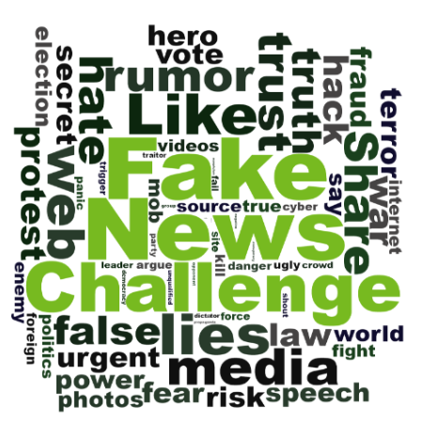
The first Fake News Challenge (FNC-1)
Organized by Pomerleau and Rao in 2017
Foster the development of AI technology to automatically detect fake news.
50 teams from both academia and industry participated
The goal is to determine the perspective (or stance) of a news article relative to a given headline.

Slide 5
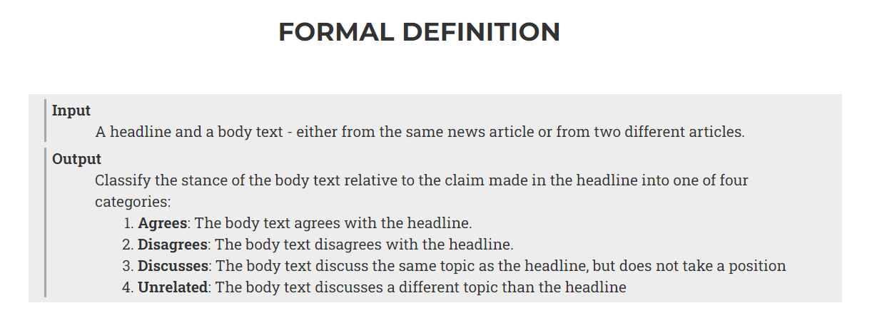
The Input and Output of the Task

Slide 6
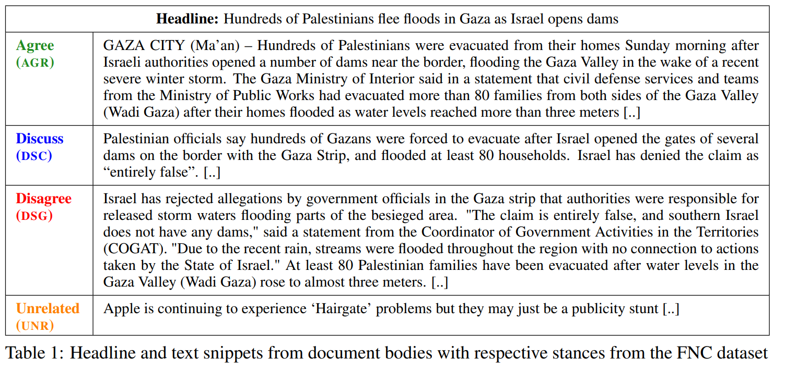
Example
[A Retrospective Analysis of the Fake News Challenge Stance-Detection Task](https://aclanthology.org/C18-1158) (Hanselowski et al., COLING 2018)

Slide 7
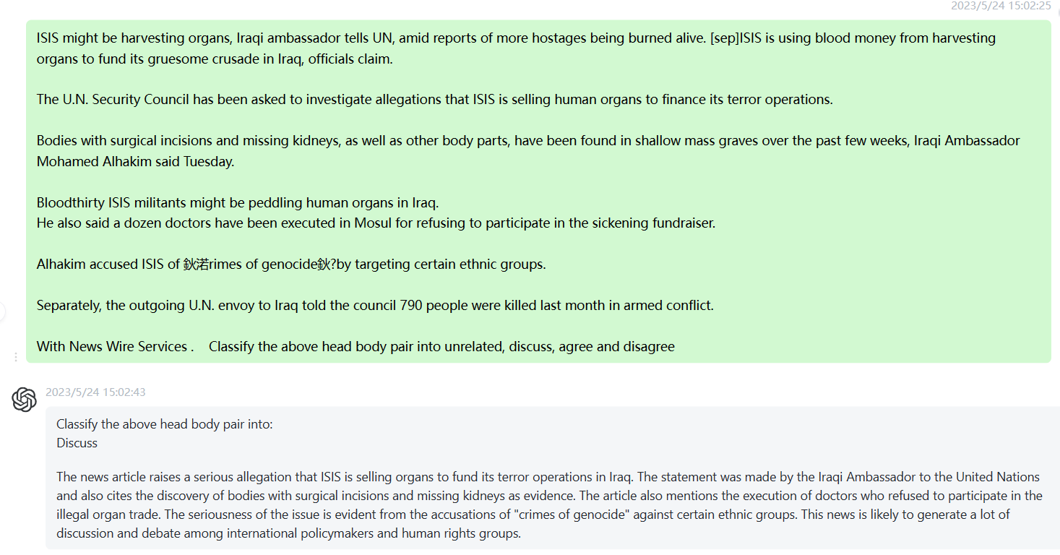
ChatGPT

Slide 8
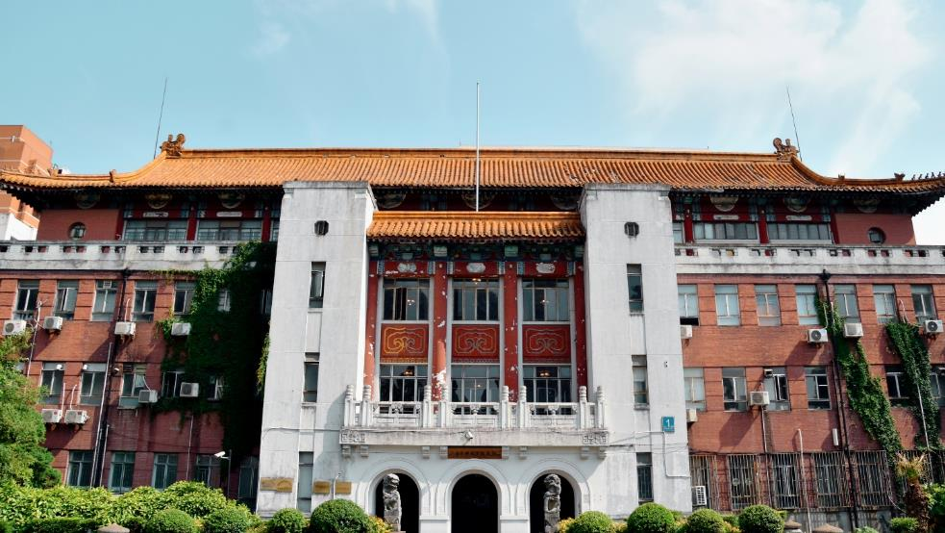
Preliminary Work
/02

Slide 9
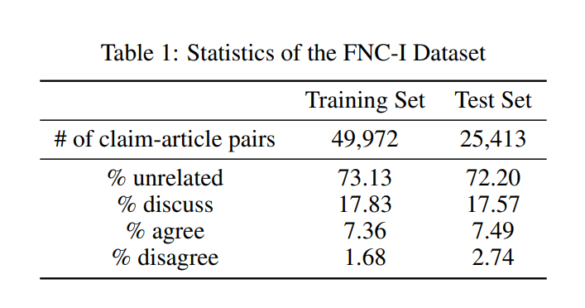
Exploratory work
Imbalanced Data !

Slide 10
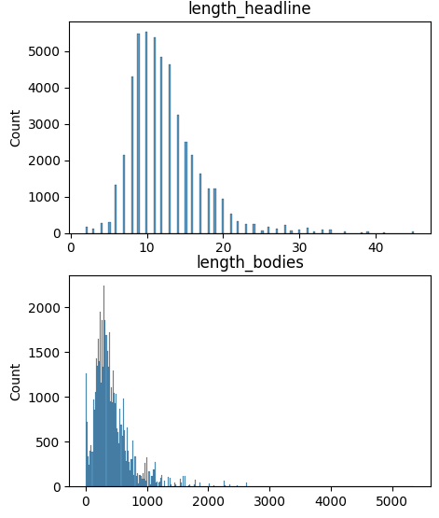
Exploratory work
A wide range of length distribution!
A large maximum length!
Length Constraints of NLP Models! E.g. Bert: 512 tokens

Slide 11
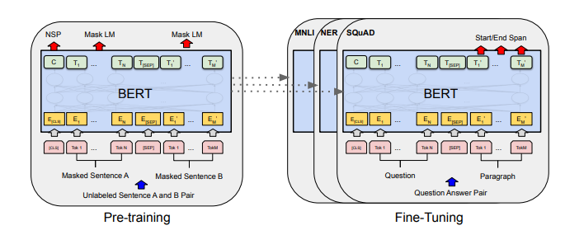
Preliminary Finetune Bert
NSP is similar to part of this task, perfect for this challenge
Proposed in 2018
Commonly used in the competition
Devlin, J., Chang, M.-W., Lee, K., & Toutanova, K. (2019). BERT: Pre-training of Deep Bidirectional Transformers for Language Understanding.

Slide 12
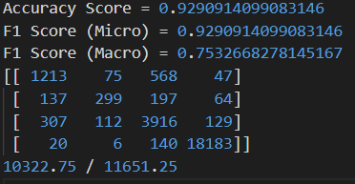
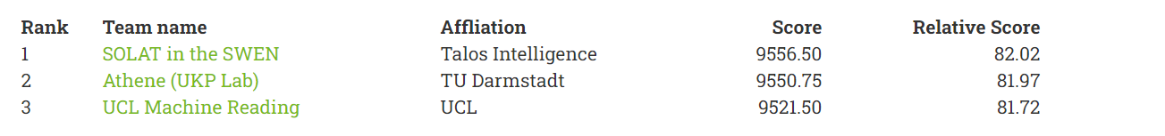
Preliminary Finetune Bert
Bert-base-uncased
Truncate to 256 tokens, use only head of bodies
Nearly 800 points higher than the previous SOTA
Micro F1 is high but Macro F1 is much lower
Still can’t distinguish minor class well

Slide 13
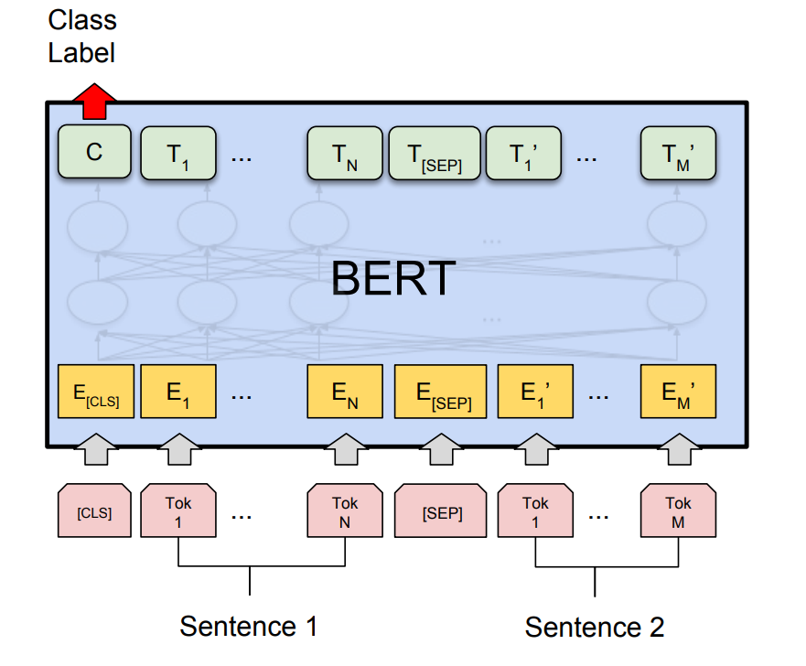
Preliminary Finetune Bert
NSP is similar to part of this task, perfect for this challenge
Proposed in 2018
Commonly used in the competition
Devlin, J., Chang, M.-W., Lee, K., & Toutanova, K. (2019). BERT: Pre-training of Deep Bidirectional Transformers for Language Understanding.

Slide 14

Related Work
/03

Slide 15
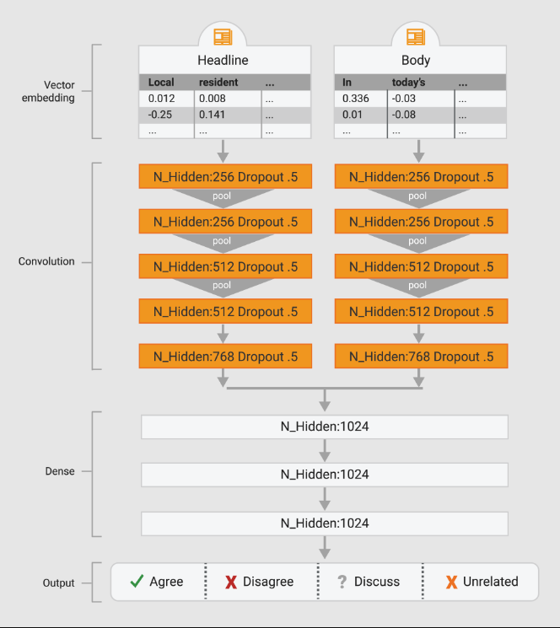
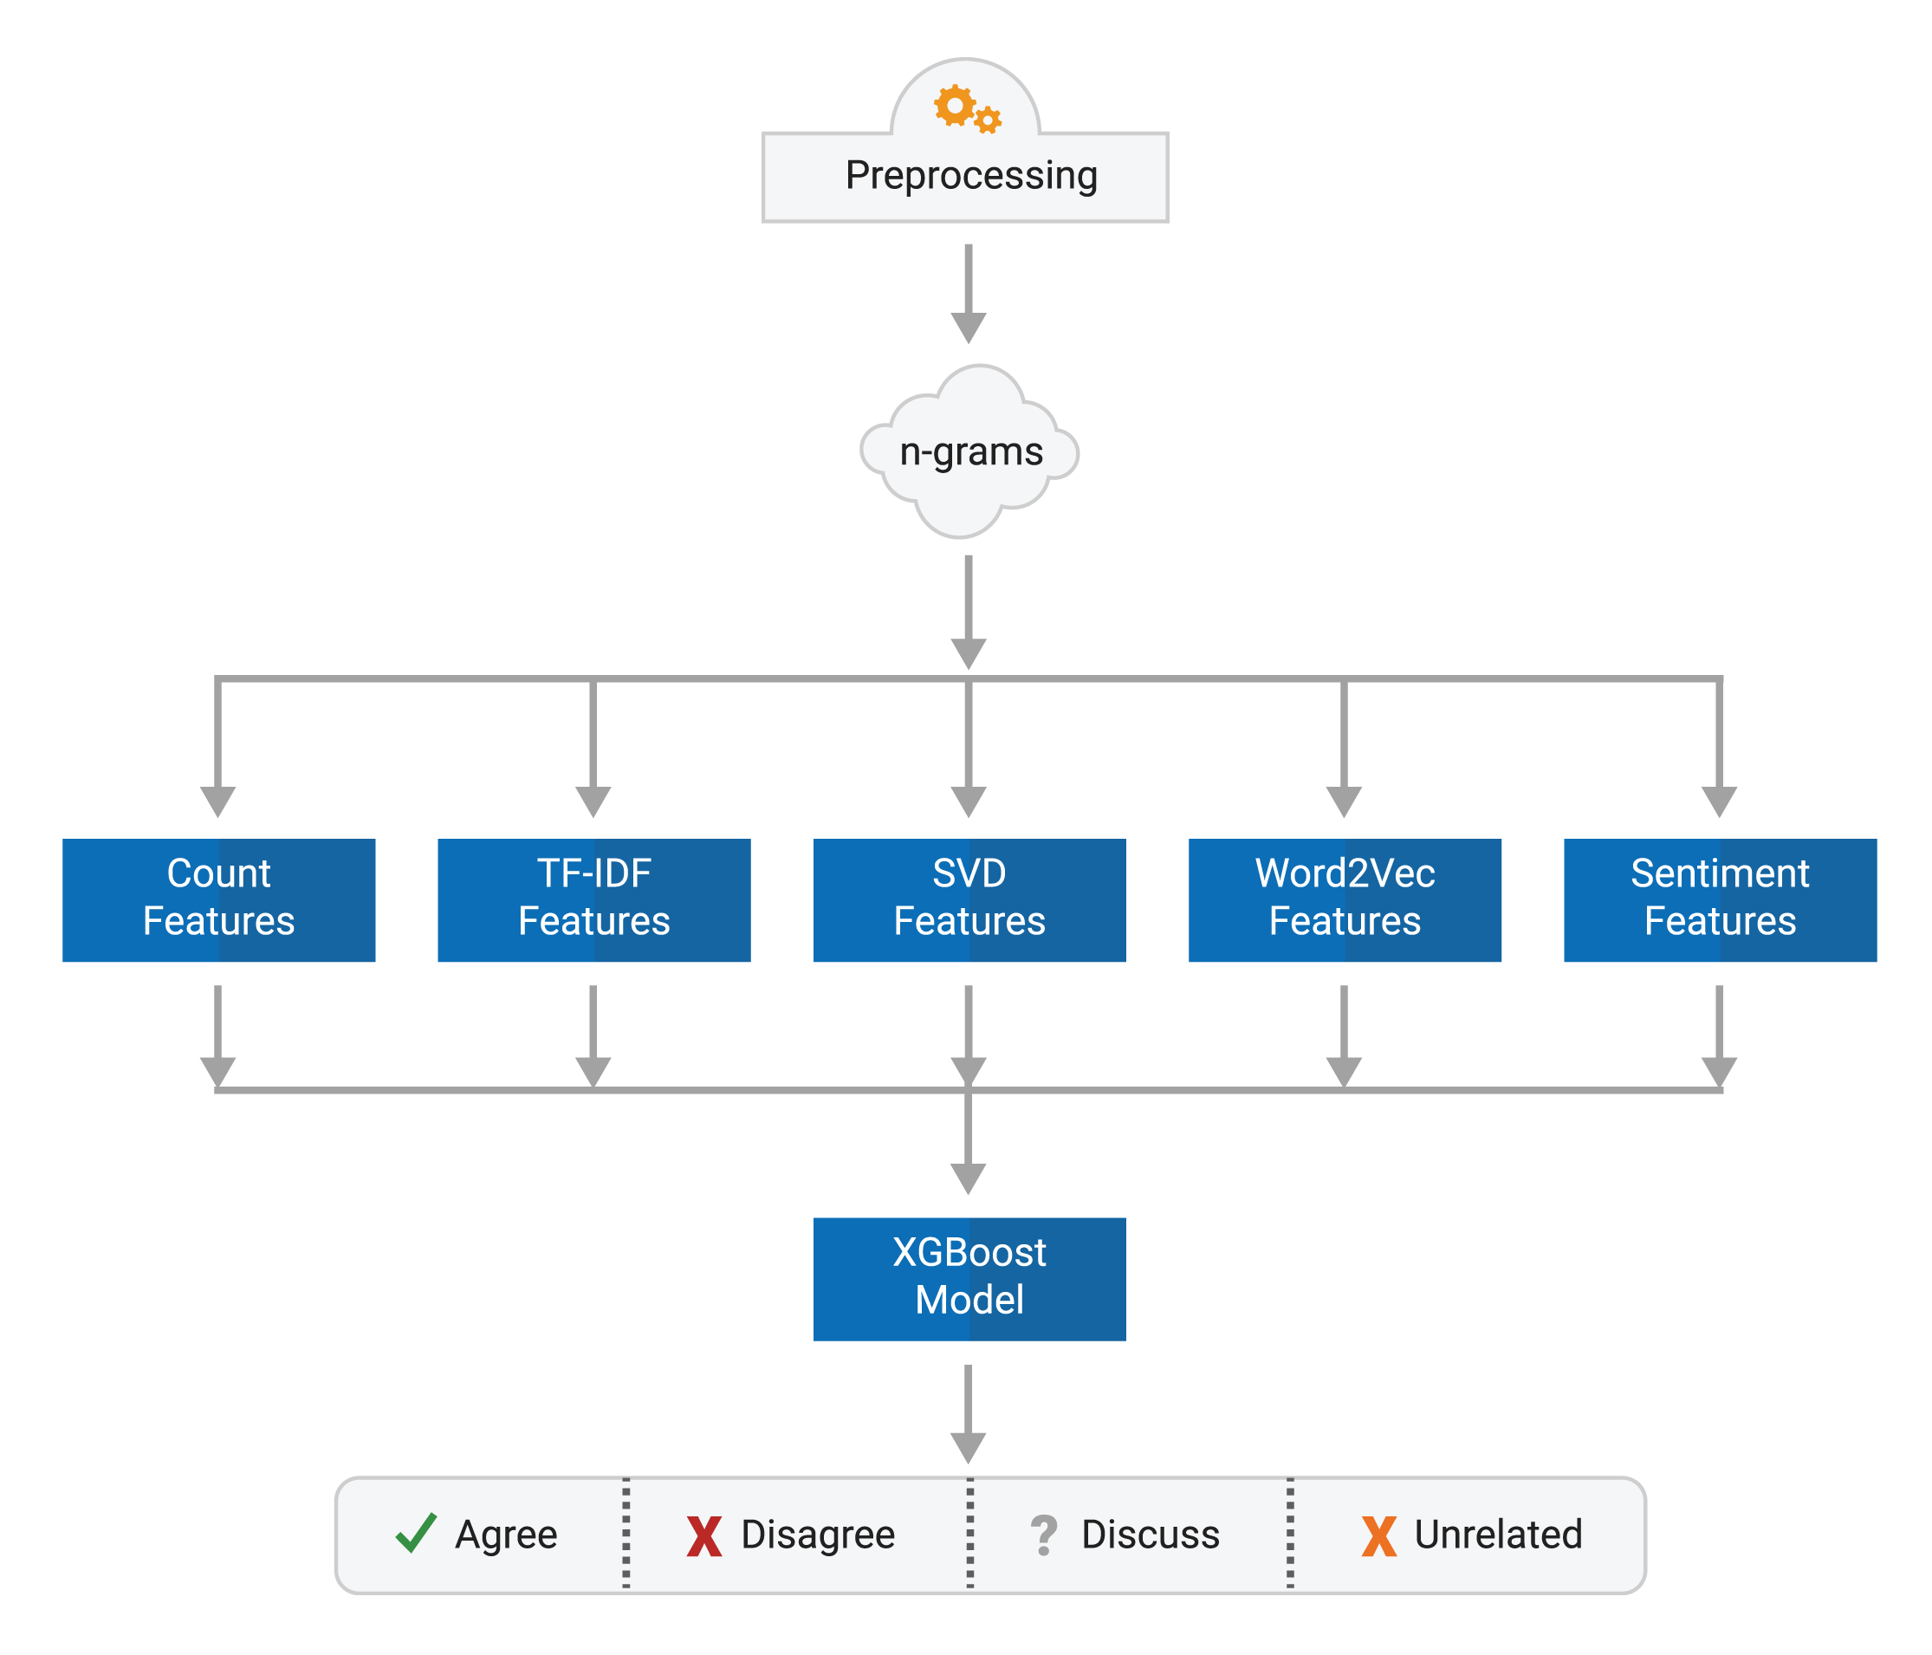
Top 1 Team
Applies a 1D Convolutional Net on the headline and body text.
Represented at the word level using the Google News pretrained vectors.
Then sent to a MLP with 4-class output and trained end-to-end.
Tokenize and stem the text, generating unigram, bigram, and trigram models.
Extract five different types of features for both the headlines and bodies:
Basic Count Feature
TF-IDF Feature
SVD Feature
Word2Vec Feature
Sentiment Feature
https://github.com/Cisco-Talos/fnc-1

Slide 16
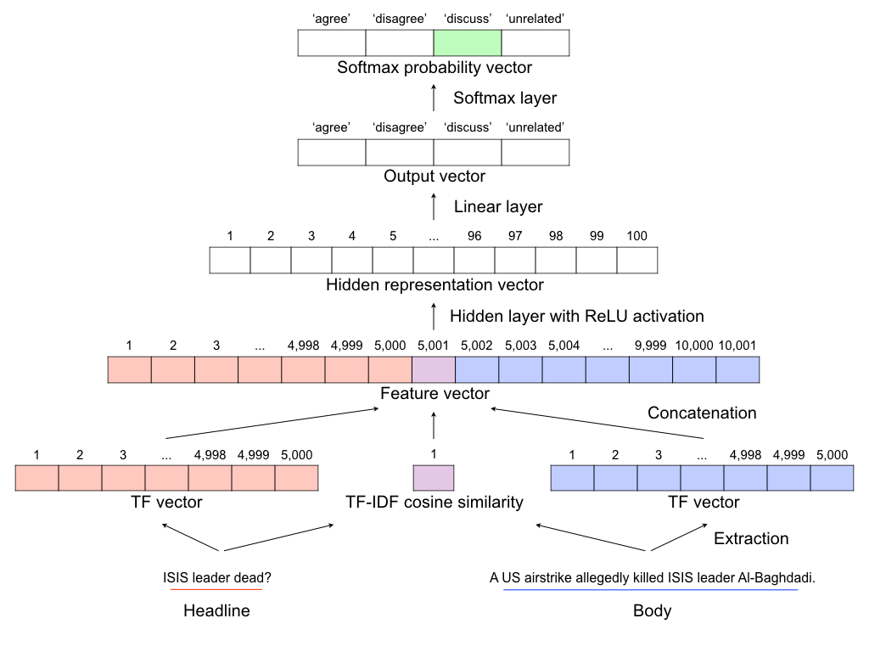
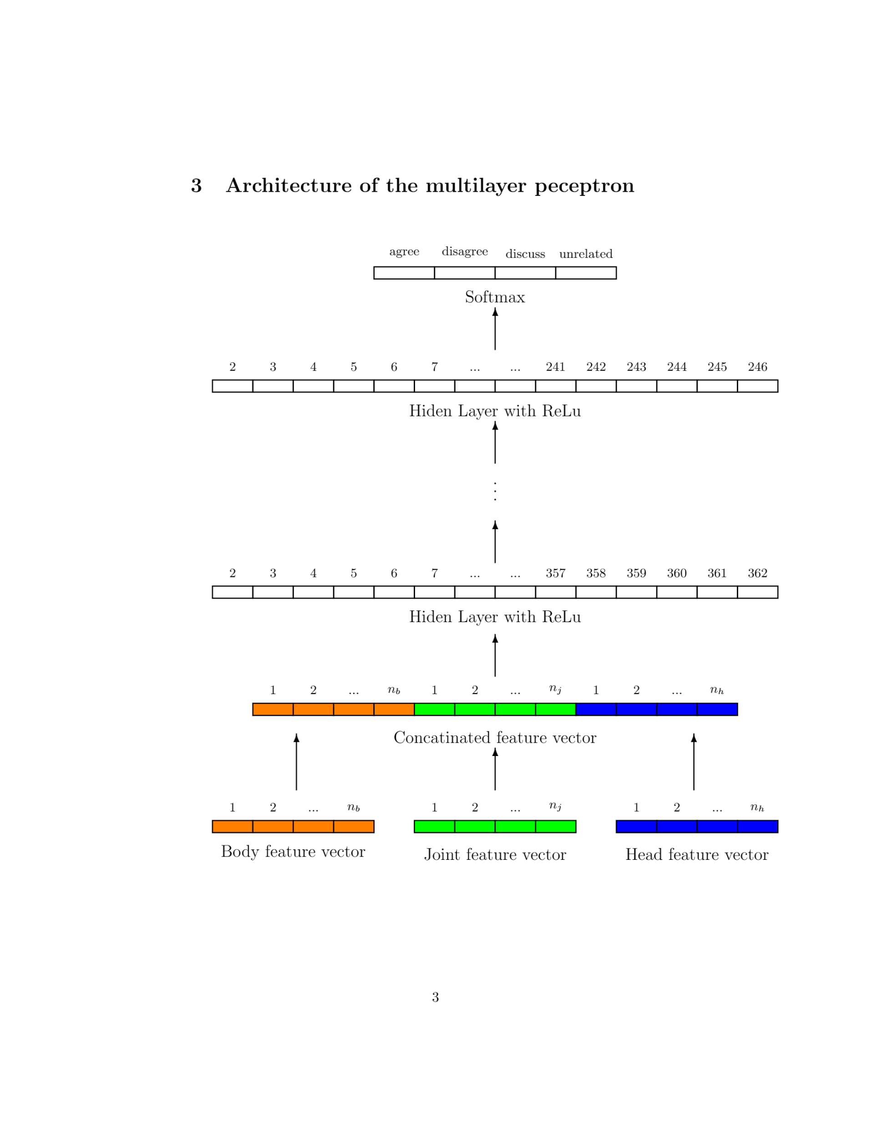
Top 2&3 Team
Extract features from many models: NMF, LDA, LSI, unigrams
Employ an ensemble of five multi-layer perceptrons (MLPs) with six hidden layers
Using multi-layer perceptron with bag-of-words features.
https://github.com/hanselowski/athene_system
https://github.com/uclnlp/fakenewschallenge

Slide 17
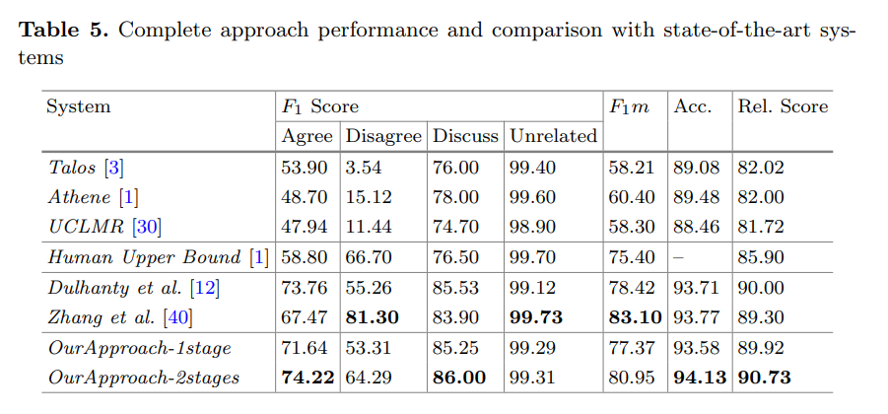
Top Team Score and human upper bound
Hanselowski, A., PVS, A., Schiller, B., Caspelherr, F., Chaudhuri, D., Meyer, C. M., & Gurevych, I. (2018). A Retrospective Analysis of the Fake News Challenge Stance Detection Task.

Slide 18
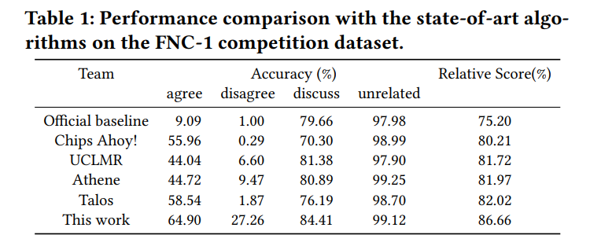

Other method: Ranking-based algorithm
Classification-based algorithms make a strong assumption that there is clear distinction between any two stances, which may not be held in the context of stance detection
Frame the detection problem as a ranking problem and propose a ranking-based method to improve detection performance
${\text{P}\text{roduces} \text{a} \text{value} u}^{+}$ for the true stance
$\text{T}\text{hree} \text{values}{ u}_{1}^{−},u_{2}^{−},u_{3}^{−}$ for three false stances
${\text{W}\text{ith} \text{the} \text{goal} \text{to} \text{satisfy} \text{this} \text{constraint}\text{:} u}^{+}≥\max\left\{u_{1}^{−},u_{2}^{−},u_{3}^{−}\right\}+1$
Qiang Zhang, Emine Yilmaz, and Shangsong Liang. 2018. Ranking-based Method for News Stance Detection. In Companion Proceedings of the The Web Conference 2018 (WWW '18). International World Wide Web Conferences Steering Committee, Republic and Canton of Geneva, CHE, 41–42.

Slide 19
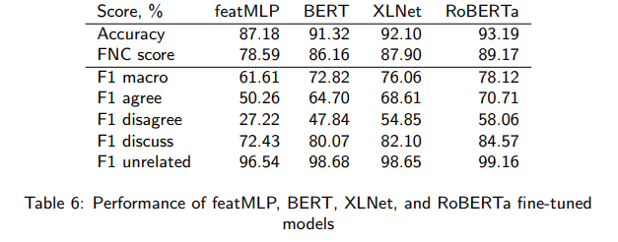
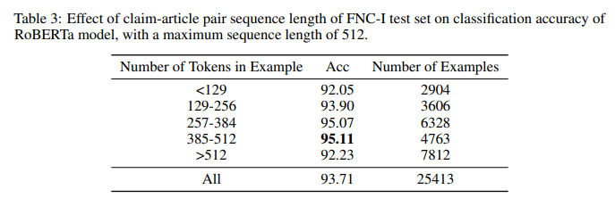
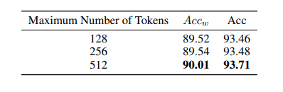
Other method: RoBERTa
RoBERTa (Robustly Optimized BERT Approach)
更大的模型参数量、更大bacth size、更多的训练数据
去掉下一句预测(NSP)任务
动态掩码
更大的 byte 级别 BPE 词汇表，包含 50K 的 subword 单元，且没有对输入作任何额外的预处理或分词
RoBERTa performs the best!
Dulhanty, C., Deglint, J. L., Daya, I. B., & Wong, A. (2019). Taking a Stance on Fake News: Towards Automatic Disinformation Assessment via Deep Bidirectional Transformer Language Models for Stance Detection.

Slide 20
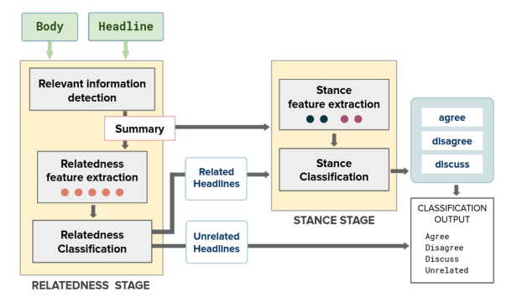
Exploring Summarization to Enhance Stance Detection
Two-stages: Relatedness Stage, and Stance Stage
Relatedness Stage
relevant information detection: TextRank extractive summarization algorithm
relatedness feature extraction:
(1) Cosine similarity between TF-IDF vector
(2) Overlap coefficient
(3) BERT cosine similarity
(4) Positional Language Model (PLM) salience score
(5) Soft cosine similarity
relatedness classification: RoBERTa
Stance Stage
Stance Feature Extraction: polarity features of the headline and the summary are computed using NLTK tool, generating four features
Stance Classification: RoBERTa(two dense layers and the Softmax classification layer), using four features above
Relatedness Stage
Input: both the text body and the headline
Output:
(1) The headlines classified as related or unrelated
(2) The summary of the news content
Stance Stage
Input: the headlines classified as related; the summary of the news content
Output: classification into one of three classes left
Sepúlveda-Torres, R., Vicente, M., Saquete, E., Lloret, E., Palomar, M. (2021). Exploring Summarization to Enhance Headline Stance Detection. In: Métais, E., Meziane, F., Horacek, H., Kapetanios, E. (eds) Natural Language Processing and Information Systems. NLDB 2021.

Slide 21
Exploring Summarization to Enhance Stance Detection
Sepúlveda-Torres, R., Vicente, M., Saquete, E., Lloret, E., Palomar, M. (2021). Exploring Summarization to Enhance Headline Stance Detection. In: Métais, E., Meziane, F., Horacek, H., Kapetanios, E. (eds) Natural Language Processing and Information Systems. NLDB 2021.

Slide 22
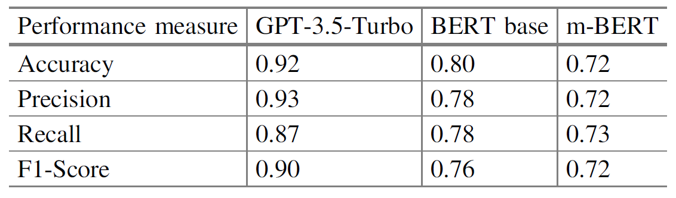
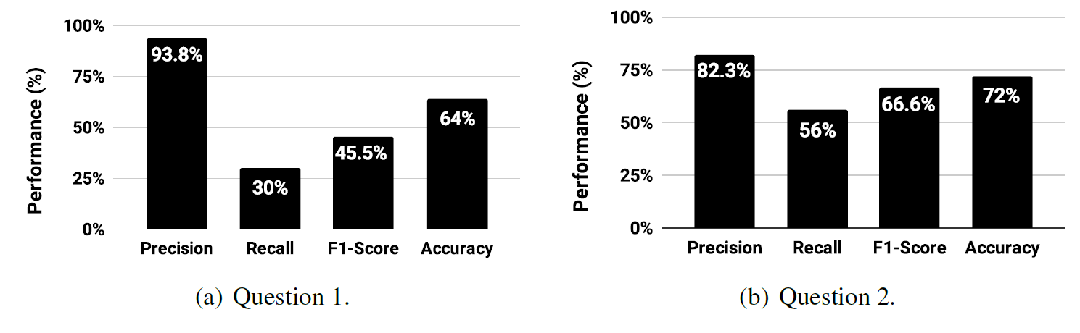
GPT model in Fake news detection
Performance of GPT-3.5 in fake news headlines detection(Stage 1) has been studied.
Compare the transformer-based BERT and the LLM, GPT-3.5-turbo after fine-tuning
text-davinci-002: A model based on GPT-3.5, trained with supervised fine-tuning
Add prompt fine-tuning:
Question 1: Does the given text is fake news? Does it Spread misinformation? Answer only with yes or no.
Question 2: Does the given text contain characteristics of fake news? Does it spread misinformation? Answer only with yes or no.
[1] Anirudh, K., Srikanth, M., Shahina, A. (2024). Multilingual Fake News Detection in Low-Resource Languages: A Comparative Study Using BERT and GPT-3.5. In: Chakravarthi, B.R., et al. Speech and Language Technologies for Low-Resource Languages. SPELLL 2023.
[2] Lucas S. Anjos, Silvio Ereno Quincozes.(2023). Investigating the Performance of the GPT-3.5 Model in Fake News Detection: An Experimental Analysis. In: Acoustics, Speech, and Signal Processing Newsletter, IEEE

Slide 23

Our Plan
/04

Slide 24
Our plan
Dealing with imbalanced data:
Oversampling the training data to introduce a bias towards "disagree" predictions.
Use a two stage approach:
Based on a two-stage approach proposed by Sepúlveda-Torres, R., which achieves SOTA in Fake news challenge(Relative Score 90.73).
Add more features such as sentiment scores, GloVe into the original approach, as well as changing the hyperparameter values, such as maximum sequence length.
Investigate the GPT model's performance on fake news challenge
Prompt fine-tuning
Considering GPT-3.5 model is trained with many fake news dataset such as FNC-1, we plan to use other datasets published after GPT-3.5 when evaluating GPT model’s performance, in order to prevent data leakage.

Slide 25
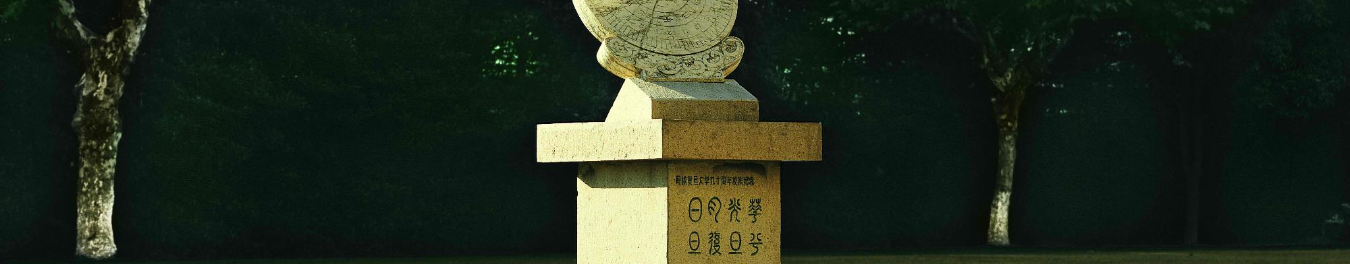
汇报完毕，请老师同学们批评指正。
THANKS

